Slide 1
CSE422: Artificial intelligence
Introduction
Fundamentals of AI
Asif Shahriar
Lecturer, CSE, BRACU

Slide 2
WHAT is AI?
The science and engineering of making intelligent machines, especially intelligent computer programs. – John McCarthy, 1956
Chess-playing AI
The science of making machines do things that would require intelligence if done by men. – Marvin Minsky, founder of MIT AI Lab
Robot vacuum cleaner
The study of agents that receive percepts from the environment and perform actions. – Stuart Russell and Peter Norvig
A self-driving car

Slide 3
Main goals of AI
Represent and store knowledge
Retrieve and reason about knowledge
Behave intelligently in complex environments
Develop interesting and useful applications
Interact with people, agents, and the environment

Slide 4
AI: Real World Impact
Public imagination
AI artist

Slide 5
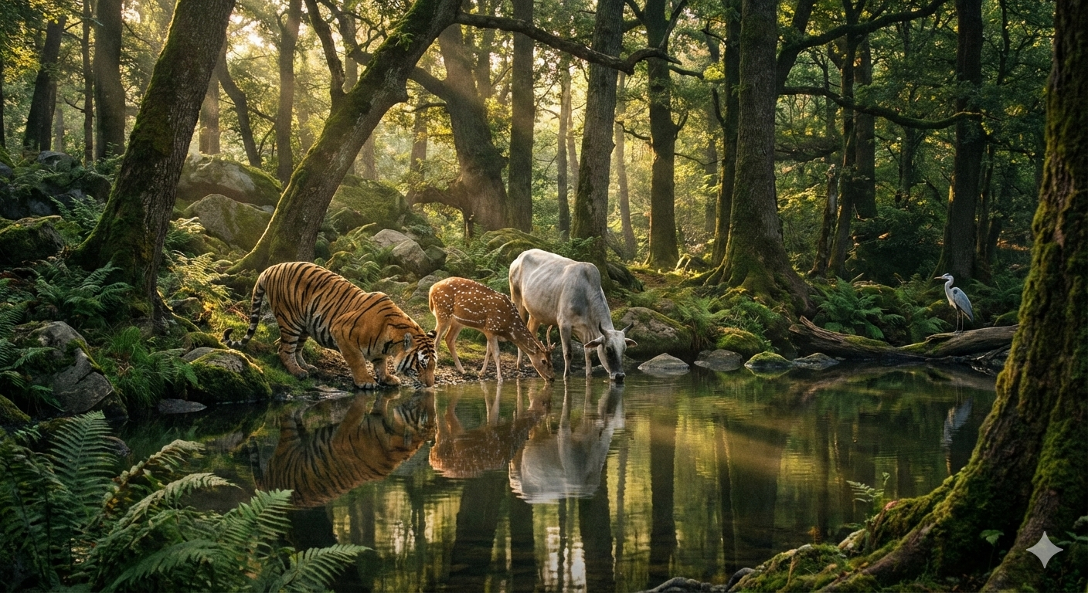
AI: Real World Impact
Prompt: “Draw an image of a natural forest, where a tiger, a deer and a cow are drinking water from the lake.”
[This image is generated by Gemini 3 Pro.]

Slide 6

AI: Real World Impact
Prompt: “Draw a Cyberpunk-style abstract picture about the sufferings of the people of Gazza.”
[This image is generated by Gemini 3 Pro.]

Slide 7
AI: Real World Impact
In the early days of the space program, they sent monkeys on mission after mission. Dozens of successful flights. Then finally, they launched their first human… along with a monkey.
Mid-flight, Mission Control radioed in:
“Monkey, engage thrusters.”
The monkey did.
“Monkey, initiate course correction.”
The monkey complied.
Then they called the human.
“Human, are you there?”
“Roger that,” he replied. “What’s my job?”
Mission Control paused, then said:
“Your job is to make sure the monkey survives. He’s the one we trained.”
A long silence.
Then a quiet reply:
“…What happens if I fail?”
“Let’s just say we’ve only packed one return capsule.”
Public imagination
AI artist
AI story-writer
Prompt: “Write a joke about an early space program that had used monkeys as astronauts for many missions, and then sent the first human astronaut into space along with a monkey. Add a slightly dark tone to the story.”
[This story is generated by GPT-4o.]

Slide 8
Which Story is Better?
After twenty missions using only chimpanzees, the Space Agency finally decided it was time to send the first human, Major Miller, into orbit. However, for safety reasons, they paired him with their most seasoned veteran, a chimp named "Subject Zero."
Before the launch, the flight director pulled Major Miller aside.
"Look, Miller," the director said gravely. "Subject Zero has done this twelve times. You haven’t. We’ve given you two sealed envelopes. Open the first one if you run into minor trouble. Open the second one only if it’s a life-or-death emergency. Otherwise, let the monkey drive."
They blast off. As soon as they reach orbit, a red warning light starts flashing on the dashboard. Panic sets in, and Miller reaches for the control stick.
WHACK!
Subject Zero slaps Miller’s hand away, screeches, flips three switches, and stabilizes the ship.
Miller, nursing his hand, remembers the envelopes. He opens the first one. The note reads: "Stop touching things. Feed the monkey his banana pellet."
Miller sighs, feeds the chimp, and sits back in silence.
Three hours later, the ship suddenly goes into a violent spin. The oxygen alarm screams. The hull creates a deafening groaning sound. Miller knows this is it. He looks at Subject Zero, but the chimp is just staring at him with cold, unblinking eyes.
Miller tears open the second envelope—the "Life or Death" envelope. His hands shake as he unfolds the paper.
The note reads: "Feed the monkey his second banana pellet. If he refuses to eat it, it means he has already ejected your seat, and you have approximately three seconds to make peace with God."
[This story is generated by Gemini 3 Pro.]

Slide 9
AI: Real World Impact
Public imagination
AI artist
AI story-writer
A serious debate
Who owns AI-generated content?
Intellectual theft during training?
Truly creative, or just a remix?
Devaluing human art and storytelling?

Slide 10
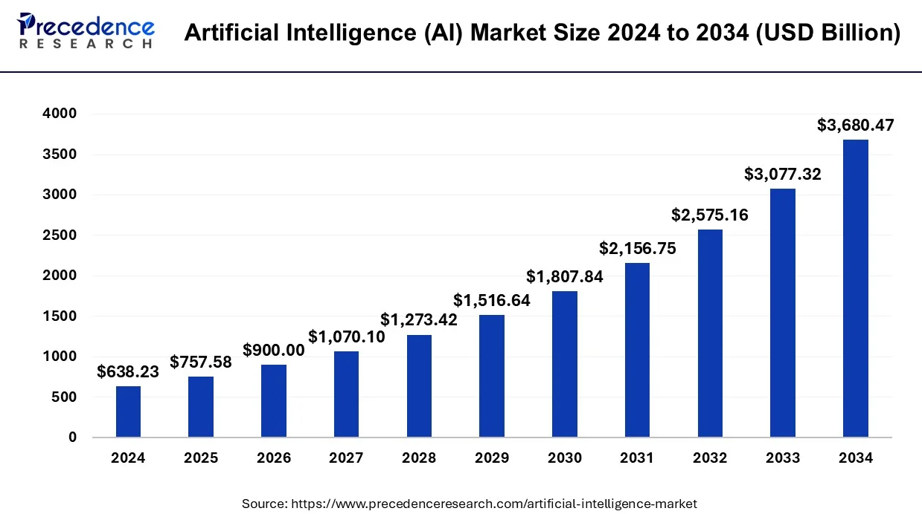
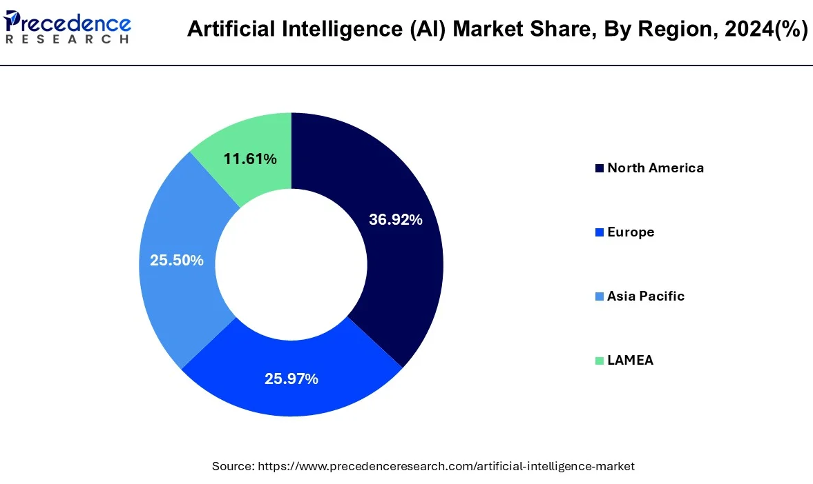
AI: Real World Impact
Public imagination
Economy

Slide 11
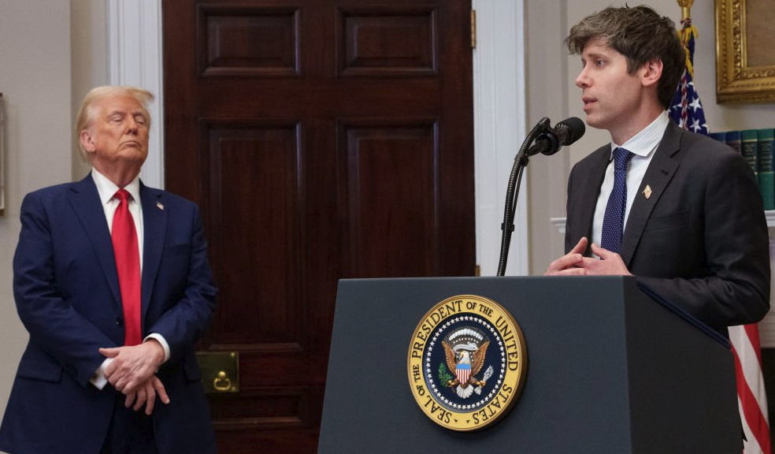
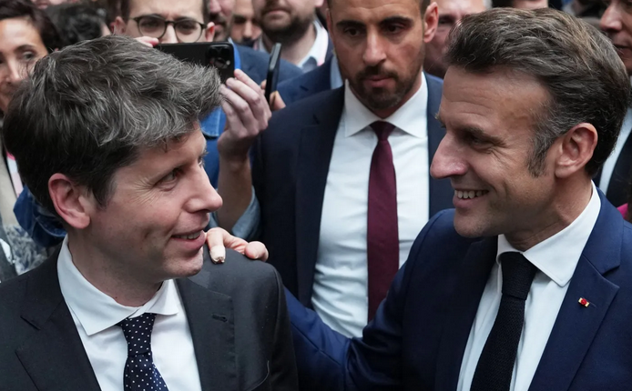
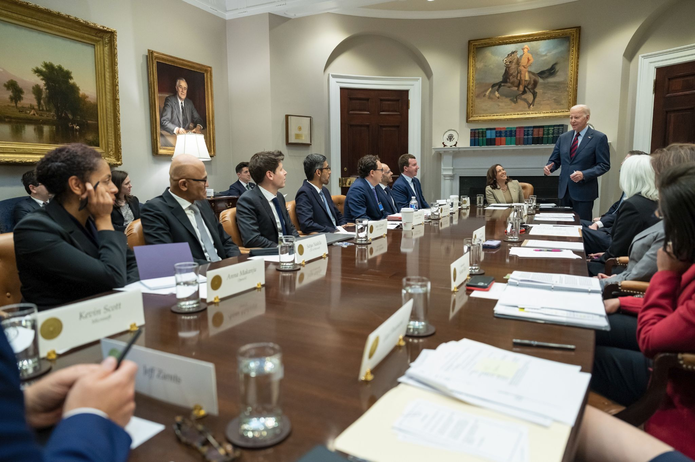

AI: Real World Impact
Public imagination
Economy
Politics

Slide 12

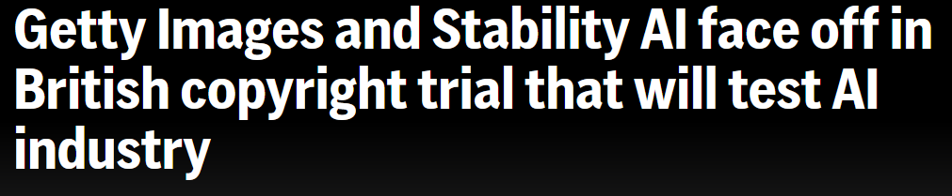

AI: Real World Impact
Public imagination
Economy
Politics
Law
Lots of lawsuits against AI companies involving copyright claims, training data, and human creativity devaluation
Who’s responsible when AI causes harm?
Laws like the EU AI Act are attempting to classify and regulate risk levels in AI systems

Slide 13
AI: Real World Impact
Public imagination
Economy
Politics
Law
Labor
Effects of automation
Demanding new skills in the face of AI
Wage polarization

Slide 14
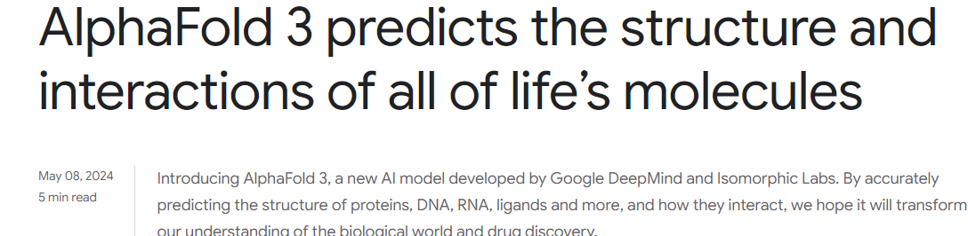
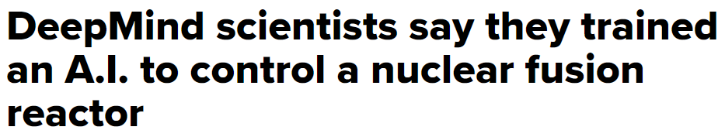
AI: Real World Impact
Public imagination
Economy
Politics
Law
Labor
Scientific advancements

Slide 15
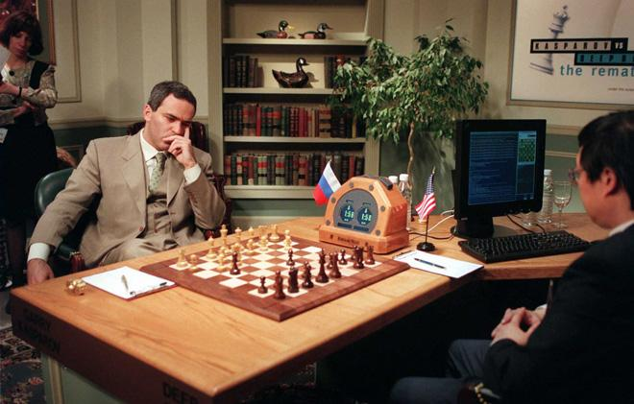
What can AI do?
Win against humans in chess?

Slide 16
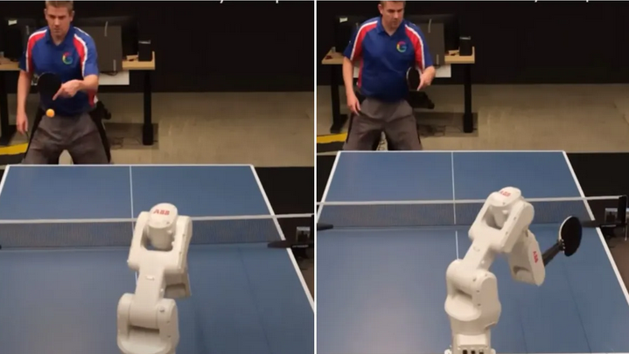
What can AI do?
Win against humans in chess?
Play a decent game of table tennis?

Slide 17
What can AI do?
Win against humans in chess?
Play a decent game of table tennis?
Unload dishwashers at home?

Slide 18
What can AI do?
Win against humans in chess?
Play a decent game of table tennis?
Unload dishwashers at home?
Drive safely along the highway?

Slide 19
What can AI do?
Win against humans in chess?
Play a decent game of table tennis?
Unload dishwashers at home?
Drive safely along the highway?
Drive safely along the streets of San Francisco, or Dhaka?

Slide 20
What can AI do?
Win against humans in chess?
Play a decent game of table tennis?
Unload dishwashers at home?
Drive safely along the highway?
Drive safely along the streets of San Francisco, or Dhaka?
Shop from the internet?

Slide 21
What can AI do?
Win against humans in chess?
Play a decent game of table tennis?
Unload dishwashers at home?
Drive safely along the highway?
Drive safely along the streets of San Francisco, or Dhaka?
Shop from the internet?
Shop from supershops like Shopno?

Slide 22
What can AI do?
Win against humans in chess?
Play a decent game of table tennis?
Unload dishwashers at home?
Drive safely along the highway?
Drive safely along the streets of San Francisco, or Dhaka?
Shop from the internet?
Shop from supershops like Shopno?
Discover or prove new mathematical theorems?

Slide 23
What can AI do?
Win against humans in chess?
Play a decent game of table tennis?
Unload dishwashers at home?
Drive safely along the highway?
Drive safely along the streets of San Francisco, or Dhaka?
Shop from the internet?
Shop from supershops like Shopno?
Discover or prove new mathematical theorems?
Perform a surgical operation?

Slide 24
What can AI do?
Win against humans in chess?
Play a decent game of table tennis?
Unload dishwashers at home?
Drive safely along the highway?
Drive safely along the streets of San Francisco, or Dhaka?
Shop from the internet?
Shop from supershops like Shopno?
Discover or prove new mathematical theorems?
Perform a surgical operation?
Identify a disease from symptoms?

Slide 25
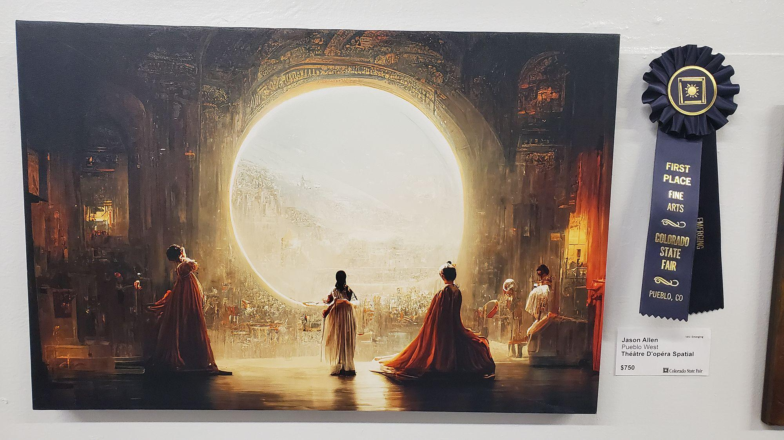
What can AI do?
Win against humans in chess?
Play a decent game of table tennis?
Unload dishwashers at home?
Drive safely along the highway?
Drive safely along the streets of San Francisco, or Dhaka?
Shop from the internet?
Shop from supershops like Shopno?
Discover or prove new mathematical theorems?
Perform a surgical operation?
Identify a disease from symptoms?
Win an art competition?

Slide 26
What can AI do?
Win against humans in chess?
Play a decent game of table tennis?
Unload dishwashers at home?
Drive safely along the highway?
Drive safely along the streets of San Francisco, or Dhaka?
Shop from the internet?
Shop from supershops like Shopno?
Discover or prove new mathematical theorems?
Perform a surgical operation?
Identify a disease from symptoms?
Win an art competition?
Write a funny story?

Slide 27
What can AI do?
Win against humans in chess?
Play a decent game of table tennis?
Unload dishwashers at home?
Drive safely along the highway?
Drive safely along the streets of San Francisco, or Dhaka?
Shop from the internet?
Shop from supershops like Shopno?
Discover or prove new mathematical theorems?
Perform a surgical operation?
Identify a disease from symptoms?
Win an art competition?
Write a funny story?
Construct a building?

Slide 28
A (short) History of AI
1940—1950: Early days: neural and computer science meet
1943: McCulloch & Pitts: Boolean circuit model of brain
1950: Turing's “Computing Machinery and Intelligence”
1950—70: Excitement! Logic-driven
1950s: Early AI programs, including Samuel's checkers program, Newell & Simon's Logic Theorist, Gelernter's Geometry Engine
1956: Dartmouth meeting: “Artificial Intelligence” adopted
1957: Newell, Shaw, Simon GPS, General Problem Solver
1965: Robinson's complete algorithm for logical reasoning
1970—90: Knowledge-based approaches
1969—79: Early development of knowledge-based systems
1980—88: Expert systems industry booms
1988—93: Expert systems industry busts: “AI Winter”

Slide 29
A (short) History of AI
1990—2010: Statistical approaches
Resurgence of probability, focus on uncertainty
1992: TD-Gammon attains human-level performance
1996: Kasparov defeats Deep Blue at chess
1997: Deep Blue defeats Kasparov at chess
2002: Embodied AI; Roomba vacuum invented
2004: First DARPA Grand Challenge robot race
2007: Checkers is solved!
2010—2017: Big Data, GPUs, Deep Learning
2010: Google self-driving cars reach their 1000th mile
2011: Apple releases SIRI
2012: AlexNet (neural net) wins ImageNet (image recognition) competition
2015: DeepMind achieves human-level control in Atari games
2016: DeepMind’s AlphaGo beat Go Master, Lee Sedol
2016: Google Translate migrates to neural networks

Slide 30
A (short) History of AI
2017—: Scaling up, Large Language Models
2017: Google invents Transformer architecture “Attention is All You Need”
2017: DeepStack and Libratus defeat humans at poker
2018-2020: AlphaFold predicts protein structure from amino acids
2021-2022: Modern text-to-image generation
2022: OpenAI release ChatGPT

Slide 31
What are we using AI for Today?
Healthcare: medical imaging analysis, disease prediction, personalized medicine, drug discovery
Business & finance: fraud detection, algorithmic trading, customer service
Retail & E-commerce: recommendation system, inventory management, AI shopping assistants
Transportation: self-driving cars, traffic management, route planning, autonomous delivery
Education: personalized learning platforms, automated grading, virtual teaching assistants
Entertainment: AI-generated music and art, content development, AI opponents in games
Cyber security: threat detection, intrusion prevention, phishing detection
Industry: Quality control, predictive maintenance, automation
Environment & agriculture: precision agriculture, wildlife conservation, climate change modelling
Scientific research: Used in almost every branch of science
Legal systems: Legal document review, predictive case outcomes
And everywhere else: Think of any field, AI is probably being used there in some form or capacity

Slide 32
Some Things AI CANNOT DO (YET)
Physical tasks in unstructured environments
General reasoning and common sense
Understand abstract humor, irony, or sarcasm across cultures
Solve problems requiring deep common-sense knowledge
Truly creative and unaided scientific discovery
AI excels in pattern recognition and remixing, but struggles with paradigm-shifting originality and insight
Ethics, emotion, and empathy
AI lacks consciousness, emotional states, and lived experience — it may simulate emotion, but cannot feel
Intent and accountability
AI cannot define its own goals — current AIs only optimize human-defined objectives
Cannot be legally or morally accountable

Slide 33
What is EASY and what is HARD?
It has been easier to mechanize many of the high-level tasks we usually associate with “intelligence” in people
e.g., symbolic integration, proving theorems, playing chess, medical diagnosis
However, it has been very hard to mechanize tasks that lots of animals can do
walking around without running into things
catching prey and avoiding predators
interpreting complex sensory information (e.g., visual, aural, …)
modeling the internal states of other animals from their behavior
working as a team (e.g., with pack animals)
Is there a fundamental difference between the two categories?

Slide 34
Human-brains vs Rationality
Brains (human minds) are very good at making rational decisions, but not perfect
Rational: maximally achieving pre-defined goals
Humans are often irrational — we make emotional, biased, or inconsistent decisions, not focused on achieving optimal results
“Brains are to intelligence as wings are to flight”
Unlike software, human-brain is hard to reverse engineer
Nonetheless, human-brain is still a great inspiration for AI
We cannot yet build AI systems on the same scale as human-brain
An AI acting rationally may not align with human values unless those values are encoded — a core challenge in AI safety

Slide 35
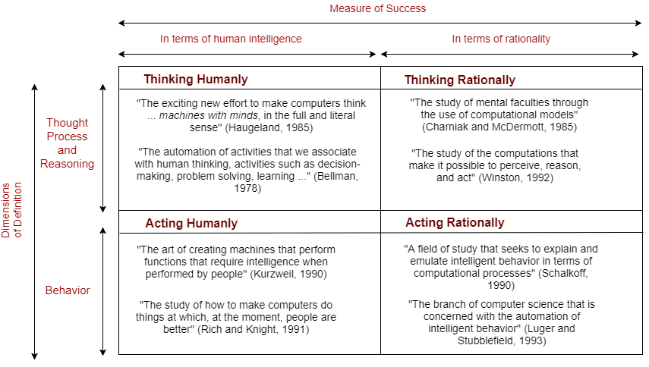
What makes a Successful AI?

Slide 36
Thinking like Human
A cognitive approach [Cognitive means being or involving conscious intellectual activity (such as thinking, reasoning, or remembering)]
Goal: Model how humans actually reason — with flaws, intuitions, biases, etc
Not just to produce human-like behavior, but to produce a sequence of steps of the reasoning process that would be similar to what a human would do to solve the same problem
Example:
Cognitive architectures like ACT-R or SOAR, which try to simulate human thought processes, including human-like errors or biases
ChatGPT mimicking human conversation styles, often using analogies and informal tone
Measure of success: Does the AI reason in the same way a human would?
Useful for: Cognitive science, psychology, human-AI interaction research

Slide 37
Acting like Human
A behaviourist approach
Goal: Make the AI behave indistinguishably from a human
Not interested in how you get results, just the similarity to what human results are
Example: The Turing Test — if a machine can hold a conversation so natural that a human can't tell it's a machine
Measure of success: Can the AI appear human in action?
Useful for: Chatbots, virtual assistants, humanoid robots

Slide 38
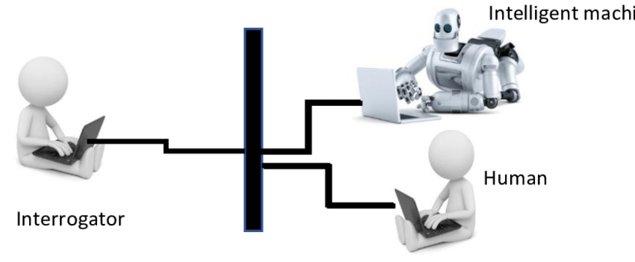
TURING TEST

Slide 39
Thinking Rationally
Goal: Use formal logic, rules, and reasoning (that can be rendered in algorithms) to reach correct conclusions
Emphasis on systems that are probably correct, and guarantee finding an optimal solution
Example:
Expert systems (e.g., logic-based medical diagnosis engines)
Chain-of-thought reasoning in LLMs
Measure of success: Does the AI follow valid reasoning paths to the right answer?
Useful for: Domains requiring logical inference — math, theorem proving, knowledge systems

Slide 40
Acting Rationally
Goal: Given goals and knowledge, take actions that maximize expected outcomes
The emphasis is to choose actions that optimize goals in uncertain environments
Can make decisions that appear non-human or counterintuitive if they maximize winning chances
Example: Intelligent agents, like self-driving cars or game-playing AIs (e.g., Stockfish for chess), that make optimal decisions
Measure of success: Does the AI choose the best possible action under uncertainty?
Useful for: Real-world decision-making, robotics, autonomous systems
Heuristic: A rule of thumb, strategy, trick, simplification, or any other kind of device which drastically limits search for solutions in large problem spaces
Heuristics do not guarantee optimal solutions (they do not guarantee any solution at all); but they can offer solutions which are good enough most of the time

Slide 41
Strong AI
Strong AI: (Hypothetical) artificial intelligence with general cognitive abilities that match or surpass human intelligence
Capable of learning, reasoning, and self-awareness (like a human)
Potential to exhibit intent, creativity, and emotional understanding
The goal of OpenAI is to create Artificial General Intelligence (AGI) – which is still a theoretical concept (some conjecture that OpenAI has already developed AGI but is holding off for commercial reasons)
Think of Samantha from the 2013 movie HER

Slide 42
Weak AI
Weak AI: Software or system designed and trained for a specific, narrow task
Does not possess (require) consciousness, self-awareness, or general reasoning ability
Does not truly understand, uses pattern recognition and statistical learning
Example:
Virtual assistants: Siri, Alexa, Google assistant
Large language models: GPT-4o, Gemini, Claude, Deepseek
Recommendation systems: Netflix, Amazon, Spotify recommendations
Specific applications: Gmail spam filter, Facial recognition systems, Autonomous vehicles, Stockfish (chess engine)

Slide 43
“The key question is not whether machines can think, but whether people can still think.” – Stuart Russell

